Slide 1

Configuring Assignment and Escalation
Editable List View

Slide 2
Lesson objectives
By the end of this lesson, you should be able to:
Describe the difference between global and default group assignment rules
Write assignment rules that assign objects to groups
Assign activities to users using common assignment methods
Explain exception rule processing
Create and test activity escalation rules
Notes:
Lesson covers assigning and escalating the Activity entity type.

Slide 3
Lesson outline
Assignment basics
Group assignment
User assignment
Activity escalation

Slide 4
Assignment in BillingCenter
In the base application, only activities and trouble tickets are assignable in the UI and through business rules
Activity
Activity
Trouble Ticket
Assign entity to a group
Assign entity to a user in the group
Assignment is either explicit or rule based
Notes:
The concept of assignment in Guidewire applications is basically equivalent to ownership. The user to whom an activity or trouble ticket is assigned is the user who owns that activity or trouble ticket and so has primary responsibility for it. An entity that can be owned in this way is said to be assignable.
A user belonging to more than one group could receive assignments through any of the groups.
Activities and trouble tickets are the only entities in the BillingCenter base application that are assignable through the UI. They are also the only entities that have associated Assignment business rules. However, various other BillingCenter entities are marked as Assignable in the data dictionary. In addition, you can make extension entities assignable.
Note: Examples of assigning trouble tickets are provided in a later lesson.

Slide 5
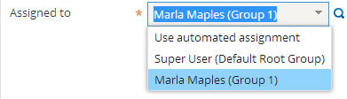


Initiating assignment from BillingCenter UI
User and group specified so assignment rules are not called
Automated assignment selected so rules are used to select group and user

Slide 6
Initiating assignment from Gosu autoAssign()
Invokes Assignment engine to assign entity on which it is invoked
Can cause assignment rules to be run
Do not call autoAssign() from an assignment rule
Signature | Assignment rules that will be run
Activity.autoAssign() | Global and Default Group
Activity.autoAssign( group, null ) | Default Group
Activity.autoAssign( group, user ) | -
Notes:
The autoAssign() method is often called as part of activity creation to perform the initial assignment.

Slide 7
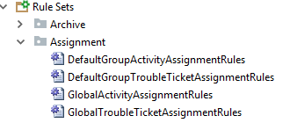
Assignment rule sets
2. Assigns a user
1. Assigns a group and may assign a user
Each assignable entity has two rule sets:
Global - assigns an object to a group, but can also assign to a user
Default Group - assigns an object to a user in assigned group
Notes:
Each assignable entity has two rule sets: Default Group and Global. Assignment is the process of running these rules. Assignment is complete either when the object has an assigned group and user or when there are no more rules left to run.
Once invoked—for example, using autoAssign() —assignment rules are run whenever an assignable entity:
Is not assigned to either a group or user, or
Is assigned to a group but not to a user
Assignment rules are not run when a user and group are specified by the user who is creating or reassigning the entity.

Slide 8

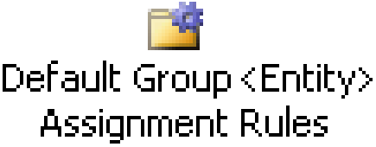
Typical flow of execution
Nothing specified
Assign to group
Also assigned to user?
yes
Group specified
no
Assign to user
Group and user specified
Done!
Notes:
The diagram above shows a typical flow of execution through assignment rules. The diagram omits processing that is required for error checking or atypical situations. The omitted processing is discussed later in this lesson.
There are two assignment circumstances:
Neither a user nor group is specified: In this case, global assignment rules are executed first. Typically, global assignment rules assign the object to a group only, not to a user. Afterwards, default group assignment rules are executed to assign the object to a user within the assigned group. (In some cases, global assignment rules can assign the object to both a group and a user in the group. In this case, default group assignment rules are skipped.)
A group and user have been specified: In this case, no rules are run. The object is simply assigned to the specified user and group.

Slide 9
AutoAssign() and execution flow
This signature … | … is equivalent to selecting this in BillingCenter
autoAssign()
autoAssign(group, null)
autoAssign(group, user)
Nothing specified
Group specified
Group and user specified
Notes:
Notice that second and third signatures in the table take the same number of arguments but differ in the argument types: the expected variables group and user are objects, not simply strings.

Slide 10
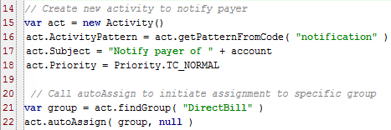
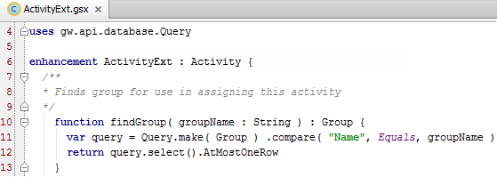
AutoAssign() example: assign to a group
Account Preupdate rule
Activity enhancment (suggested)
Default Group rule set will be run because group is assigned, but user isn't
Notes:
The example initiates the assignment of a new activity to the Direct Bill group. The Preupdate rule depends on a suggested enhancement to the Activity entity. The enhancement provides the findGroup() query method, which returns a group that matches a group name. An example of a second method, findUser(), is shown on a later slide.

Slide 11
Common assignment strategies
Assign to a specific group and then round-robin among users
Round robin ignores users that lack permission to own the object
Round-robin functionality can be configured to take into account user workload/load factors
Assign to a specific group and user
Notes:
The slide above describes some common approaches to object assignment, but it is by no means an exhaustive discussion of how assignment can or is done.

Slide 12
Common assignment methods
Used only in assignment rules
Context | Method | Object | Assigns to...
Group | assignGroup() | Any | Named group
Group | assignGroupByRoundRobin() | Any | Group by group type
User | assign() | Any | Named user and group
User | assignUserAndDefaultGroup() | Any | Named user and default group
User | assignUserByRoundRobin() | Any | Next user in the group (in a cyclical fashion)

Slide 13
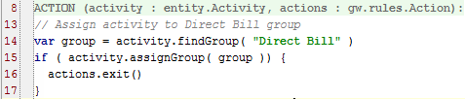
Always exit rule when assignment succeeds
Avoid reassigning an entity that has just been assigned
Assignment methods return boolean values
True → assignment was successful
False →unsuccessful, appropriate group (or user) could not be found
Place methods in if/exit wrapper to exit rule set as needed
if (assignMethod) { actions.exit() }
If assignment is successful, ensures that no other assignment is done
Notes:
After you have assigned an object to its final group, there is no reason to continue in the rule set. Furthermore, there is some risk that a rule further down in the list will reassign your entity to another group in a way that you do not want. Therefore, it is important to execute the actions.exit() method as soon as the object has an appropriate group assignment. By wrapping the assignment method inside an IF command, you will exit the rule set if and only if the assignment is successful. It is best practice to use this approach for every assignment method in your assignment rule sets.
In the example above, BillingCenter executes the assignGroup() method for a given activity. If the method is able to assign the activity to a group (in this case, the Direct Bill group), then the method returns true and the rule set is exited. If the method is unable to assign the activity to the group, then the method returns false, and execution proceeds with the next assignment rule.
The assignGroup() method is discussed later in this lesson. The findGroup() method is defined in a suggested enhancement to the Activity entity that was shown in a previous example.
Note: The actions object (on which the code invokes the exit function) is an object provided by the Guidewire infrastructure and not something that you need to declare.

Slide 14
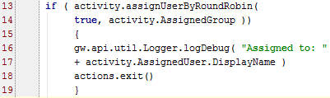

Logging an assignment
Logging assignments is always good practice

Slide 15
Lesson outline
Assignment basics
Group assignment
User assignment
Activity escalation

Slide 16

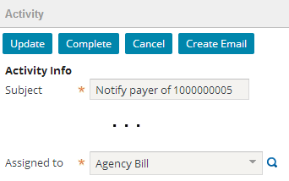
Assigning to a specific group
Syntax: object.assignGroup ( group )
Notes:
The activity is assigned directly to the Agency Bill group. If the assignment is successful, then the rule set is exited. If for some reason the assignment is unsuccessful (for example, the group does not exist), then the next assignment rule is executed.
The findGroup() method is defined in a suggested enhancement to the Activity entity that was shown in a previous example.

Slide 17
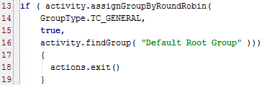
Assigning to a group by round robin
assignGroupByRoundRobin
First assigns object to specified parent group, then uses round-robin algorithm to assign object to a child group
Syntax: object.assignGroupByRoundRobin (groupType, includeSubGroups, group)
Note: All BillingCenter configured groups are children of Default Root Group
Note: All BillingCenter configured groups are children of Default Root Group
Notes:
Because BillingCenter has a group structure where all configured groups are children of the default root group (meaning, there is no configured group hierarchy), you can use assignGroupByRoundRobin() to evenly distribute assignments among all of the groups. The groupType of general is given to all BillingCenter groups other than the default root group. Default Root Group is the parent group from which the round-robin will be done.

Slide 18
What if group assignment fails?
Nothing specified
Assign to group
Was group assigned?
Assign to Default Owner and root group
no
yes
Assigned to user?
yes
no
Assign to user
Group and user specified
Done!
Notes:
After global assignment rules have been executed, the assignment engine checks to see whether the object was assigned to a group. If the object has not been assigned to a group, then it is assigned to a dummy user called Default Owner and to the root group of the hierarchy. (If the object was assigned to a group, then assignment proceeds as normal.)
Default Owner is a dummy user used for objects that fail group assignment. You cannot log on as Default Owner, and there is typically extra overhead in identifying items assigned to Default Owner and reassigning them to a real user. In general, it is considered bad practice to have a rule set that results in objects being assigned to the Default Owner.

Slide 19
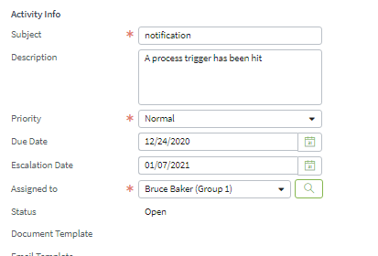
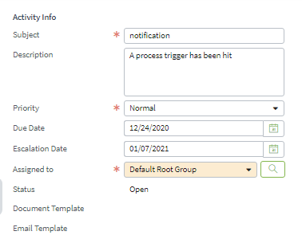
Global assignment outcomes
If global assignment is successful, object is assigned to group
Subsequently, default assignment rules assign object to a user
If global assignment is unsuccessful, object is assigned to root group and Default Owner

Slide 20
Lesson outline
Assignment basics
Group assignment
User assignment
Activity escalation

Slide 21
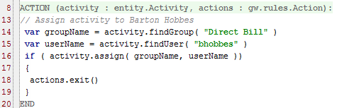
Assigning to a specific user
assign assigns object to both a group and user
Syntax:
object.assign( group, user )
Called from either global or default group rules
Notes:
Note that this method technically assigns both the group and the user (as both parameters are required). However, you can regard this method as a user assignment method. In most cases, when you are selecting a particular user, the group that the user in is determined by default. This method could be called from either global or default group rules. If it is called from global rules, then the object will have an assigned user at the end of execution of that rule set, and therefore the Default Group rule set will not execute.

Slide 22
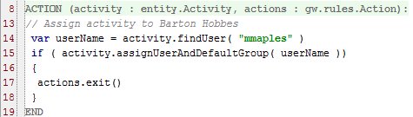
Assigning to a user and any group
assignUserAndDefaultGroup()assigns object to a user and any group that the user belongs to
Syntax: object. assignUserAndDefaultGroup (User)
Always assigns to both a group and user
Called from either global or default group rules
Notes:
This method can be called from either global or default group rules. If it is called from global rules, then the object will have an assigned user at the end of execution of that rule set, and therefore the Default Group rule set will not execute.

Slide 23

Assigning activity to entity creator
assignToCreator assigns activity to user who created the source entity and to any group that the user belongs to
Syntax: activity.assignToCreator (sourceEntity)
Assigns activity to the user who created associated trouble ticket
Notes:
This method can be called from either global or default group rules. If it is called from global rules, then the object will have an assigned user at the end of execution of that rule set, and therefore the Default Group rule set will not execute.
Note: The Activity entity has fields that track who created and last updated the activity (CreateUser, UpdateUser). These fields are managed by the system only and should never be used in user-written configuration code.

Slide 24

Assigning to a user by round robin
assignUserByRoundRobin utilizes a round-robin algorithm to assign work to a set of users in sequence
Syntax: object. assignUserByRoundRobin (includeSubGroups, group)
Round-robin within assigned group
Notes:
This method utilizes a round-robin algorithm to distribute work to a set of users, in sequence. It has two parameters:
group –defines the set of users that the work should be distributed among. In the example, Activity.AssignedGroup is the value that was assigned in the global rule set.
includeSubGroups – if false, the method distributes among the users in the group parameter only. If true, the method also includes users in all of the group's subgroups in the distribution. All defined groups are automatically subgroups of the root group. Using this function with the root group and includeSubGroups=true results in round-robining among all users in all groups defined within BillingCenter.
Note: The current number of objects assigned to any of the users is not taken into account.

Slide 25
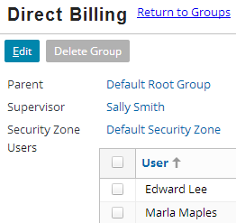
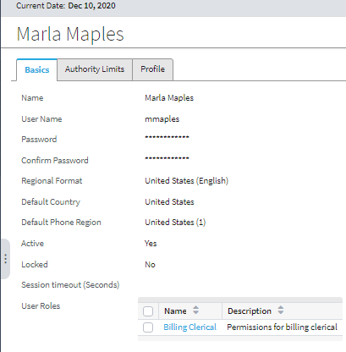
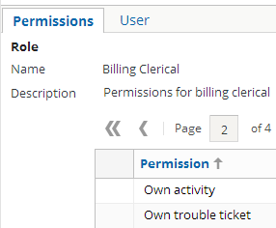
Attributes that influence round robin
Round robin ignores users:
Who lack permission to own the object
Who have an inactive status
Notes:
If there are no valid users within the selected group (and its subgroups, if the first parameter is true), then assignByRoundRobin returns false. This could occur because:
There are no users in the group.
There are no users in the group with sufficient permission to own the item. (For example, an activity routed to a group of users, none of whom have permission to own activities.)
A user who does not have own <object> permissions is ignored by assignByRoundRobin when assigning objects of that type.

Slide 26
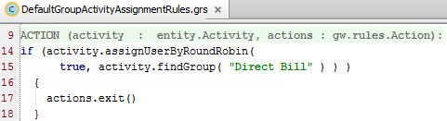
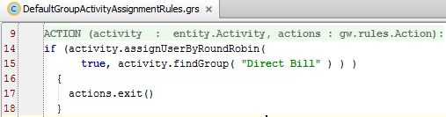
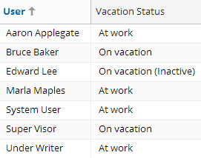
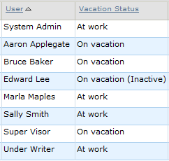
Round robin example
Assignment rule
Result of assigning same activity 12 times
Super Visor Bruce Baker Aaron Applegate Marla Maples Super Visor Bruce Baker Aaron Applegate Marla Maples Super Visor Bruce Baker Aaron Applegate Marla Maples
Users in Direct Bill group
Marked inactive
Does not have permission to own activities
Notes:
Round robin assignment assigned users with a vacation status of At work and On vacation, but it ignored Edward Lee, who has a status of On vacation (Inactive). Notice also that Under Writer was not assigned because this user lacks the permission to own activities.

Slide 27
What if user assignment fails?
Nothing specified
Assign to group
Nothing specified
no
Default Owner and root group
Was group assigned?
yes
Was user assigned?
yes
no
Assign to user
yes
Was user assigned?
no
yes
New group assigned?
no
Assign to group supervisor
Done!
Notes:
After default group assignment rules have been executed, the assignment engine checks to see if the object was assigned to a user. There are three possible outcomes:
If the object was assigned to a user, then the assignment is done.
If the object was not assigned to a user, but it was assigned to a new group, then the default group rules are re-executed. This behavior can be used to have an object travel between groups before being assigned to a user at the appropriate group level. (This strategy is of limited use in BillingCenter, which has no group hierarchy, since the final group assignment is typically made in the Global rule set.)
If the object was not assigned to either a user or a new group, then the object is assigned to the supervisor of the current group. This assignment behavior is inherent to the assignment engine and cannot be modified.
Logging messages at the WARN level identify when an object cannot be assigned to a user within the Default Group rule set.

Slide 28
Complete flow of assignment rules
Nothing specified
Assign to group
no
Default Owner and root group
Was group assigned?
yes
Group specified
Was user assigned?
yes
no
Assign to user
yes
Was user assigned?
no
yes
New group assigned?
no
Group and user specified
Assign to group supervisor
Done!
Notes:
The diagram above represents the complete flow of assignment rules.

Slide 29
Lesson outline
Assignment basics
Group assignment
User assignment
Activity escalation

Slide 30

Exception rules
Identify objects that need attention, such as:
Work that has not been completed on time
Provide appropriate action, such as:
Creating additional activities, often for a supervisor
Are executed on a scheduled basis
In base application, once every 30 minutes
Notes:
BillingCenter has one exception rule set, for activity escalation. Other Guidewire products, which use the same platform, have multiple exception rule sets.

Slide 31
Batch process escalates activities
activity escalation
The activity escalation batch process runs on a scheduled basis
Causes rules in Activity Escalation rule set to be run
Rules are executed against activities that:
Have not yet been escalated
AND
Have an escalation date on or before the current date
Escalated activities are flagged in the UI
Notes:
In the base application, the only behavior assigned to overdue or escalated activities is the way in which they appear in activity lists. BillingCenter can be configured to add special functionality for overdue or escalated activities. The simplest approach to handling escalated activities is to create an activity for the group supervisor to check on the reason the work is not yet complete. An example of this functionality is shown later in this lesson.
After an activity has been escalated, the activity escalation rule set is not run against the activity again.
Note: Trouble tickets can also be escalated, but there are no trouble ticket escalation rules. When the Trouble Ticket Escalation batch process runs, it sets TroubleTicket.Escalated to true. You could write a Preupdate rule to test whether a trouble ticket has been escalated.

Slide 32
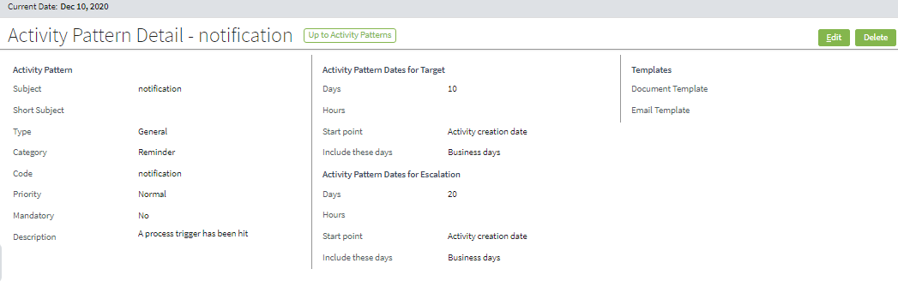
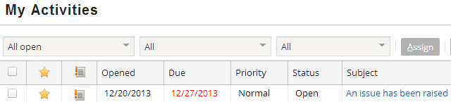
Specifying when to escalate an activity
Activity Opened: 12/20/2013 Escalation days: 20 Escalate on: 01/09/2014
Notes:
The activity pattern specifies the point at which an activity created from that pattern is to be escalated. The escalation point is expressed as a number of days or hours after a specified event.
In the BillingCenter base application, the only behavior given to escalated activities is the way in which they appear in activity lists. (The escalated icon appears in the escalated column for activities that have been escalated.)

Slide 33
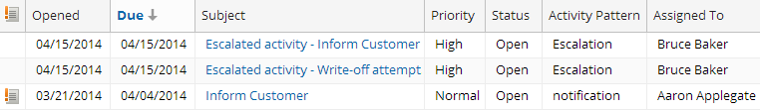
Activity escalation rule example (1 of 3)
Requirement: Whenever an activity is escalated:
Create an escalation activity
Assign the new activity to the supervisor of the escalated activity's assigned group
When this activity was escalated, the escalation activity was created and assigned to the group supervisor
Notes:
The code to satisfy the requirement is on the next slide. The Escalation activity pattern also needs to be created.

Slide 34
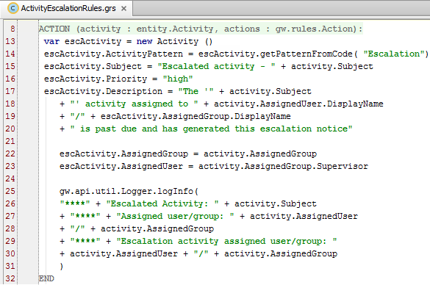
Activity escalation rule example (2 of 3) creating escalation activity
Notes:
In the highlighted section on the slide:
A new activity is created.
It is associated with the Escalation activity pattern. The getActivityPatternFromCode() method and the Escalation activity pattern were defined as part of configuration.
The Subject, Description, and Priority fields are set for the new activity.
The explanation continues on the next slide.

Slide 35
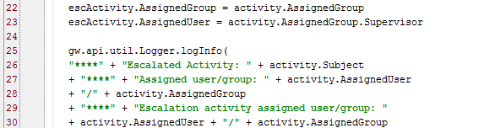

Activity escalation rule example (3 of 3) assigning escalated activity, logging activity
Assign the new activity to the supervisor of the group to which the escalated activity is assigned
Perform assignment here (not in assignment rules) because you can access supervisor information here
ruleexecution.log
Notes:
In the top highlighted section (continuing from previous slide):
Set the new activity's group to the same group as the group of the escalated activity.
Set the new activity's user to the supervisor of the group that the escalated activity belongs to.
The subject of the escalated activity and its assigned user and group are written to the log file. The assigned user and group for the escalation activity are also written to the log file.

Slide 36
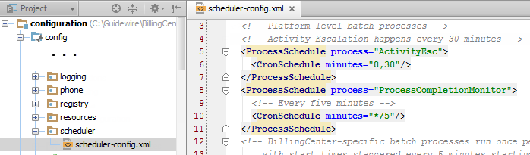
Scheduling activity escalation
BillingCenter scheduler launches many batch processes including activity escalation
scheduler-config.xml contains entries for batch processes that can be scheduled
Notes:
You use the scheduler-config.xml file to schedule when and how often activity escalation rules are run. You can access this file in Studio under configuration→Config→scheduler.
The ProcessSchedule tag describes when the process is run. It contains attributes that specify the exact timing, such as once an hour or every night. You can use a combination of one or more of the following attributes: seconds, minutes, hours, dayofmonth, month, and dayofweek. You also can use the following special characters:
* for all values
, to separate additional values; for example dayofweek="MON,WED,FRI"
/ to specify increments; for example minutes="0/15" means start at minute zero and run every 15 minutes
L to specify the last day of a week or month
See the BillingCenter System Administration Guide for more information about specifying schedules.

Slide 37

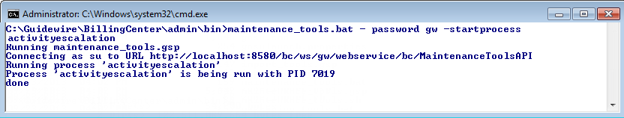
Three places to test exception rules
Run Activity Escalation process in BillingCenter using:
QuickJump field OR
Internal Tools
Run Activity Escalation process from command line
Notes:
When creating or modifying exception rules, you need to test your new rules without waiting until the scheduled batch process runs. You can run the Activity Escalation batch process from three places:
BillingCenter QuickJump field
Guidewire Internal Tools
Command line
The maintenance_tools command-line utility enables you to run various batch processes, including activityescalation. This batch process runs the activity escalation rules.
In training, use gw as the administrative password.
For more information about the maintenance_tools command, see the BillingCenter System Administration Guide.

Slide 38
Lesson objectives review
You should now be able to:
Describe the difference between global and default group assignment rules
Write assignment rules that assign activities to groups
Assign activities to users using common assignment methods
Explain exception rule processing
Create and test activity escalation rules

Slide 39
Notices
Copyright © 2001-2014 Guidewire Software, Inc. All rights reserved.
Guidewire, Guidewire Software, Guidewire ClaimCenter, Guidewire PolicyCenter, Guidewire BillingCenter, Guidewire Reinsurance Management, Guidewire ContactManager, Guidewire Vendor Data Management, Guidewire Client Data Management, Guidewire Rating Management, Guidewire InsuranceSuite, Guidewire ContactCenter, Guidewire Studio, Guidewire Product Designer, Guidewire Live, Guidewire DataHub, Guidewire InfoCenter, Guidewire Standard Reporting, Guidewire ExampleCenter, Guidewire Account Manager Portal, Guidewire Claim Portal, Guidewire Policyholder Portal, ClaimCenter, BillingCenter, PolicyCenter, InsuranceSuite, Gosu, Deliver Insurance Your Way, and the Guidewire logo are trademarks, service marks, or registered trademarks of Guidewire Software, Inc. in the United States and/or other countries.
All other trademarks are the property of their respective owners.
This material is confidential and proprietary to Guidewire and subject to the confidentiality terms in the applicable license agreement and/or separate nondisclosure agreement.
This file and the contents herein are the property of Guidewire Software, Inc. Use of this course material is restricted to students officially registered in this specific Guidewire-instructed course, or for other use expressly authorized by Guidewire. Replication or distribution of this course material in electronic, paper, or other format is prohibited without express permission from Guidewire.
Guidewire products are protected by one or more United States patents.

Slide 40
Demo
6

Slide 41
Provide demo details and link to the demo video
7

Slide 42
Lab
6

Slide 43
Complete the exercises listed in “Lesson 1: Configuring Assignment” and “Lesson 2 Configuring Escalation”chapter in the “BillingCenter 10 Configuration: Essentials - Student Workbook“
7

Slide 44
Review
6

Slide 45
This is for Review questions and answers
7

